Slide 1
Final Project: Radiation Mapping
Elliott Canton, Augustina Jolly, Vivian Smart-Stewart

Slide 2
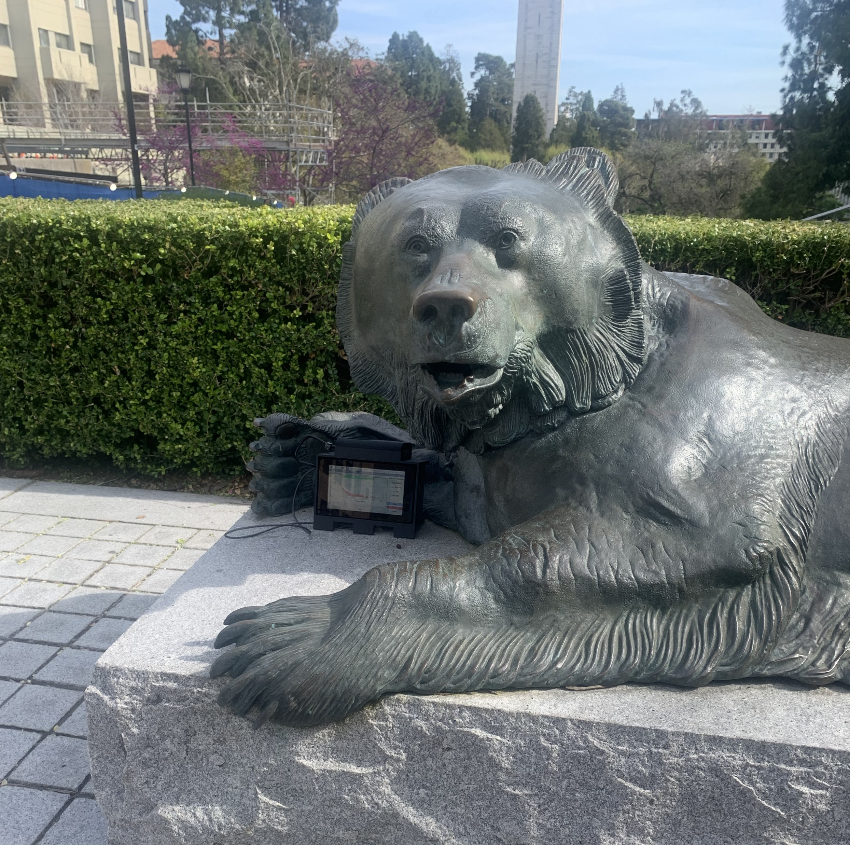
Thesis
Urban terrain alters the amount of radiation detected from natural geographic sources of radiation.
Variable Considerations:
Time of collection
Weather variation
Human presence

Slide 3
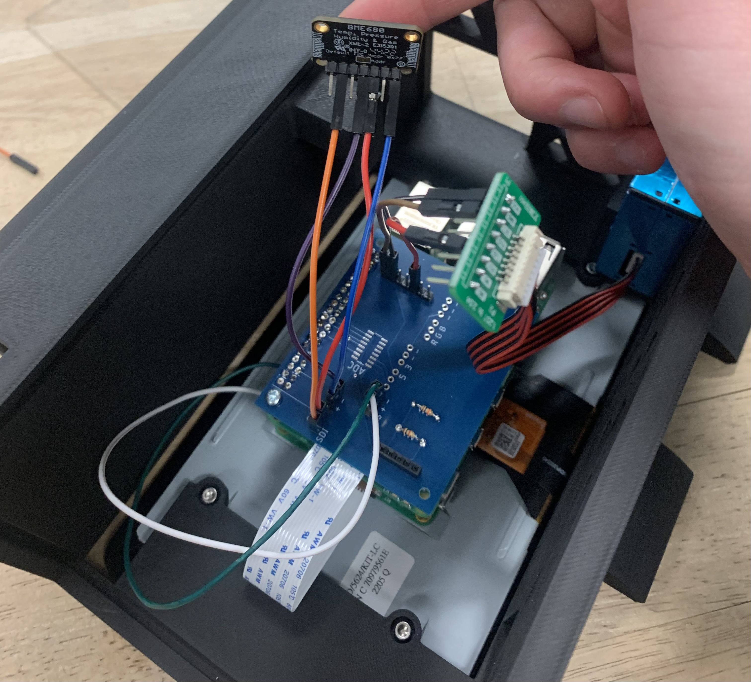
Collection Procedure
Ensure proper sensor setup and connections
Test of the detection cycle indoors
Sensor functions
Data Storage Locations
File Types (2 CSV files)
Set collection intervals
15 minutes total
2 second intervals
Repeat collection at all 7 location
Repeat if errors occur

Slide 4
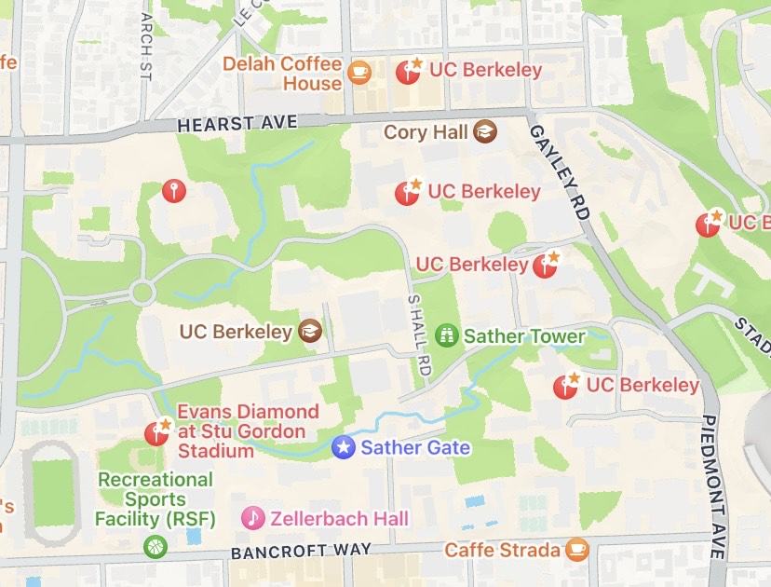
Map of Data Points
Etcheverry Breezeway
College of Chemistry Latimer Hall
McLaughlin Patio, Construction site
Gateway Construction Site
Foothill Parking lot and Amphitheatre Construction Site
Faculty Club
Stu Gordon Stadium

Slide 5
Analysis Procedure

Slide 6
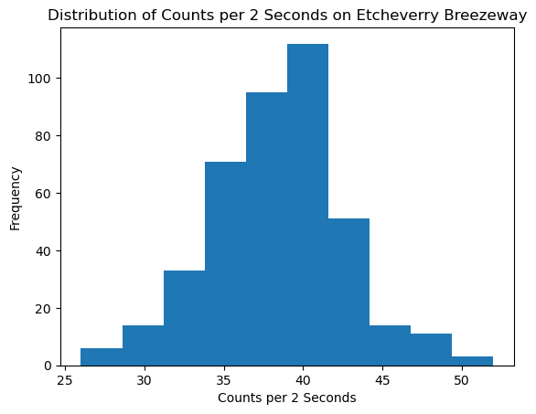
Location 1: Etcheverry Breezeway
Data

Slide 7
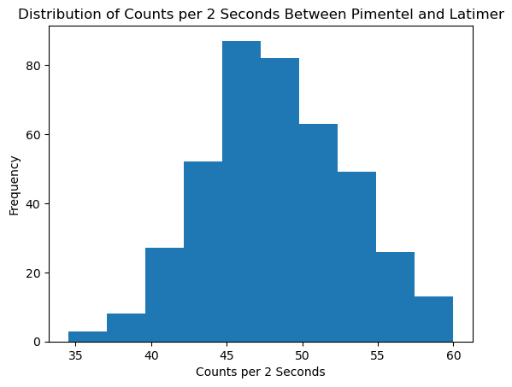
Location 2: College of Chemistry, Latimer Hall
Data

Slide 8
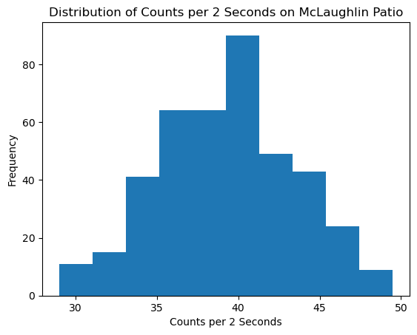
Location 3: McLaughlin Patio, Construction Site
Data

Slide 9
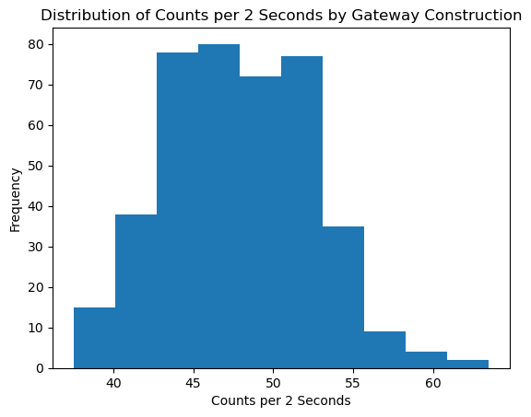
Location 4: Gateway Construction Site
Data

Slide 10
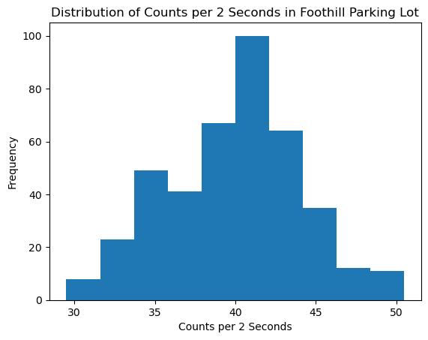
Location 5: Foothill Parking Lot and Amphitheatre Construction
Data

Slide 11
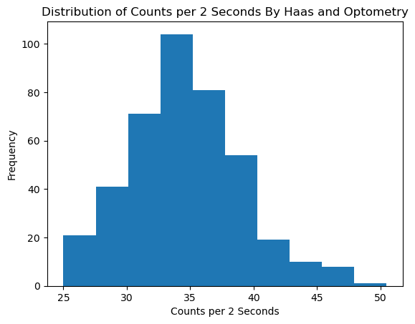
Location 6: Faculty Club
Data

Slide 12
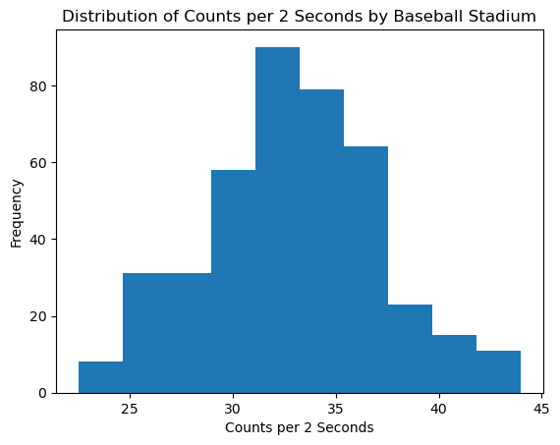
Location 7: Stu Gordon Stadium

Slide 13
Irregular Data

Slide 14
Conclusions

